Slide 1

StarBound
From Biomass to Beyond
Hussein Rezk
Aaron Casas
Adil Feratovic
Christian Rojas
Joshua Laforest
1

Slide 2
Overview
01
02
03
Introduction
Competing Processes
Plant Location
Problem and Significance
Market Analysis and Pricing
Competition of the chosen process
BFDs of competing processes
Location
Incentives
04
Chemistry
05
BFD
06
PFD
Reactions and Bio-Oil
General description of the process
Material Balance
3 Stage Process
2

Slide 3
Introduction
3

Slide 4
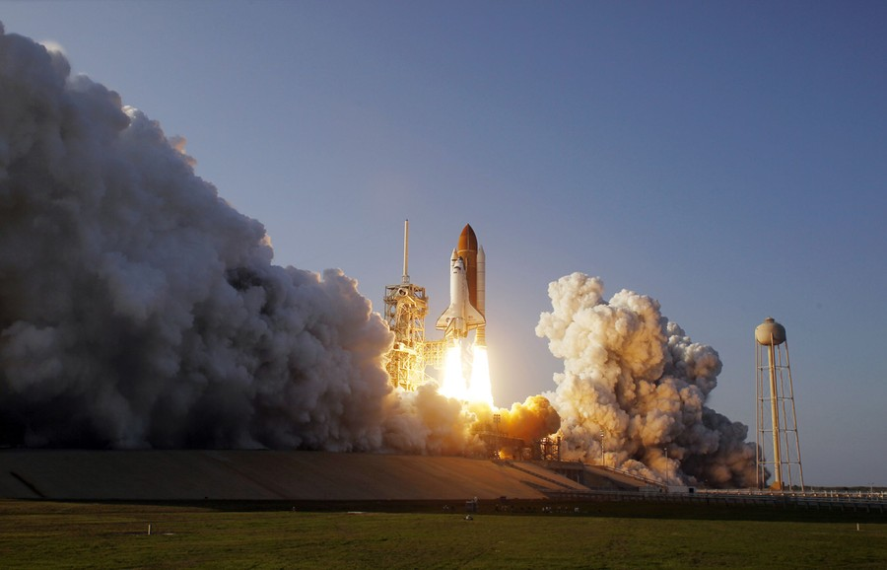
Problem and Significance
Space industry is expected to hit $1.8 trillion by 2035
Current RP-1 is made using fossil fuels, high scope 1 emissions
Amazon adopting net-zero policies in their efforts to launch space satellites
4
Taylor, A. (2011, February 24). Space shuttle discovery’s final launch. The Atlantic.
https://www.theatlantic.com/photo/2011/02/space-shuttle-discoverys-final-launch/100015/

Slide 5
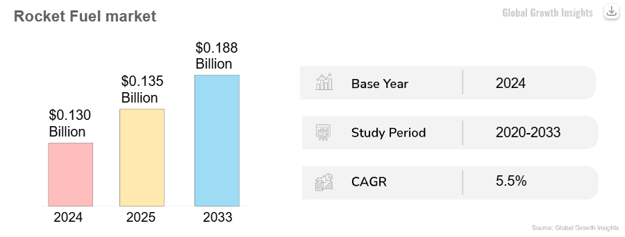
Supply-Demand Analysis
Global Growth Insights. (2025, June 18). Rocket Fuel Market Size, share & report [2033]. Rocket Fuel Market Size, Share & Report [2033].
https://www.globalgrowthinsights.com/market-reports/rocket-fuel-market-115202
Space industry is expected to hit $1.8 trillion by 2035
Average growth rate of 9% per year
Limited supply since there are limited suppliers
5

Slide 6
Global Share
Location | Global Rocket Fuel Demand | Rocket Fuel Used
US | 35-40% | LOX/RP-1, LOX/methane
Asia-Pacific | 30-35% | LOX/LH2
Europe | 20-25% | LOX/LH2
Middle East & Africa | 5-10% | LOX/RP-1
In 2024, the US averaged 60-70 launches weekly
China launched over 60 missions in 2023
6

Slide 7
Material Prices
Continuous Feedstock | 1st Run | Continuous Product
Hybrid poplar wood chips | H2 | RP-1
$0.03/bone dry pound delivered | $3/pound | $4.60/pound
7

Slide 8
Sustainable RP-1 Price
RP-1 from petroleum: $1.04/lb – $1.57/lb
Sustainable aviation fuel (SAF) is around 2-5 times more
expensive than fossil jet fuel
Average RP-1 price: $1.31/lb
Average of the multiplier: 3.5
Sustainable RP-1 price: $4.60/lb
8

Slide 9
Competing Processes
9

Slide 10
Standard Crude Oil
Companies: Space X, Northrop Grumman, United Launch Alliance (ULA)
Pros
Standard global scale refinery exists
Low production cost, cheaper than most bio derived fuels
No need for pyrolysis, gasification, or hydrotreating during the process
Cons
High carbon emissions, crude-derived fuels have some of the highest carbon dioxide cycle emissions out of most fuel choices
Fossil crude is a finite resource
Deep desulfurization and purification needed. Crude oil contains many impurities such as sulfur, nickel, vanadium, etc.
10

Slide 11
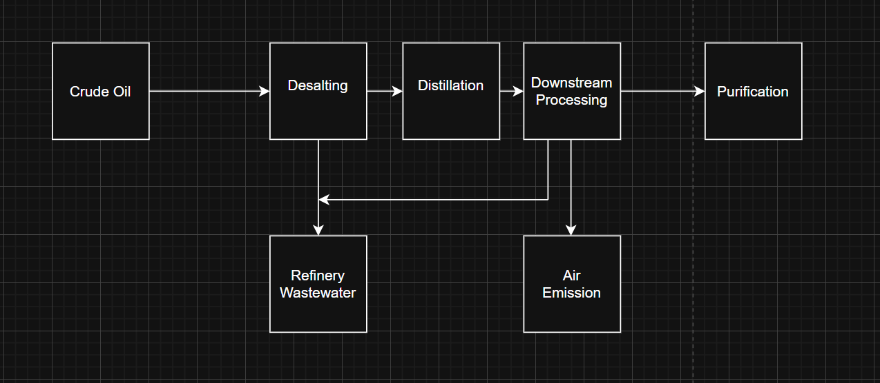
11

Slide 12
Bio-Propane
Companies: Orbex, BluShift Aerospace
Pros
High energy density
Clean combustion, reduced soot and sulfur oxides emitted
Storable at moderate pressures
Cons
High production costs due to limited propane supply and hydrogen inputs
Risking of coking (carbon deposits)
12

Slide 13
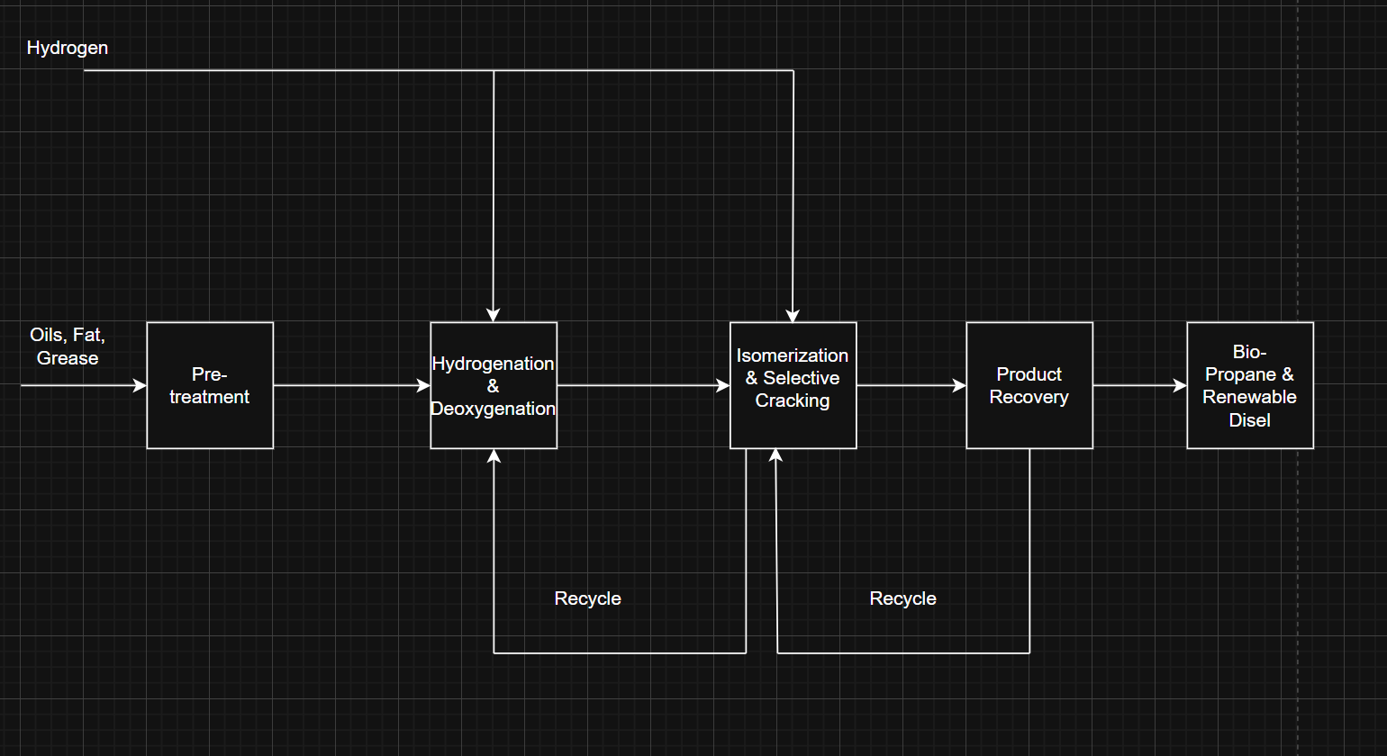
13

Slide 14
Bio–Liquid Hydrogen
Companies: Air Water Inc, Interstellar Technologies
Pros
Highest specific efficiency of the chemical propellants
Zero carbon dioxide emissions
Produced from biomass gasification biomass gasification → syngas → H₂ purification
Cons
Complex infrastructure and handling compared to methane or kerosene
Hydrogen embrittlement and leakage issues
Requires deep cryogenic storage with active boiloff management
14

Slide 15
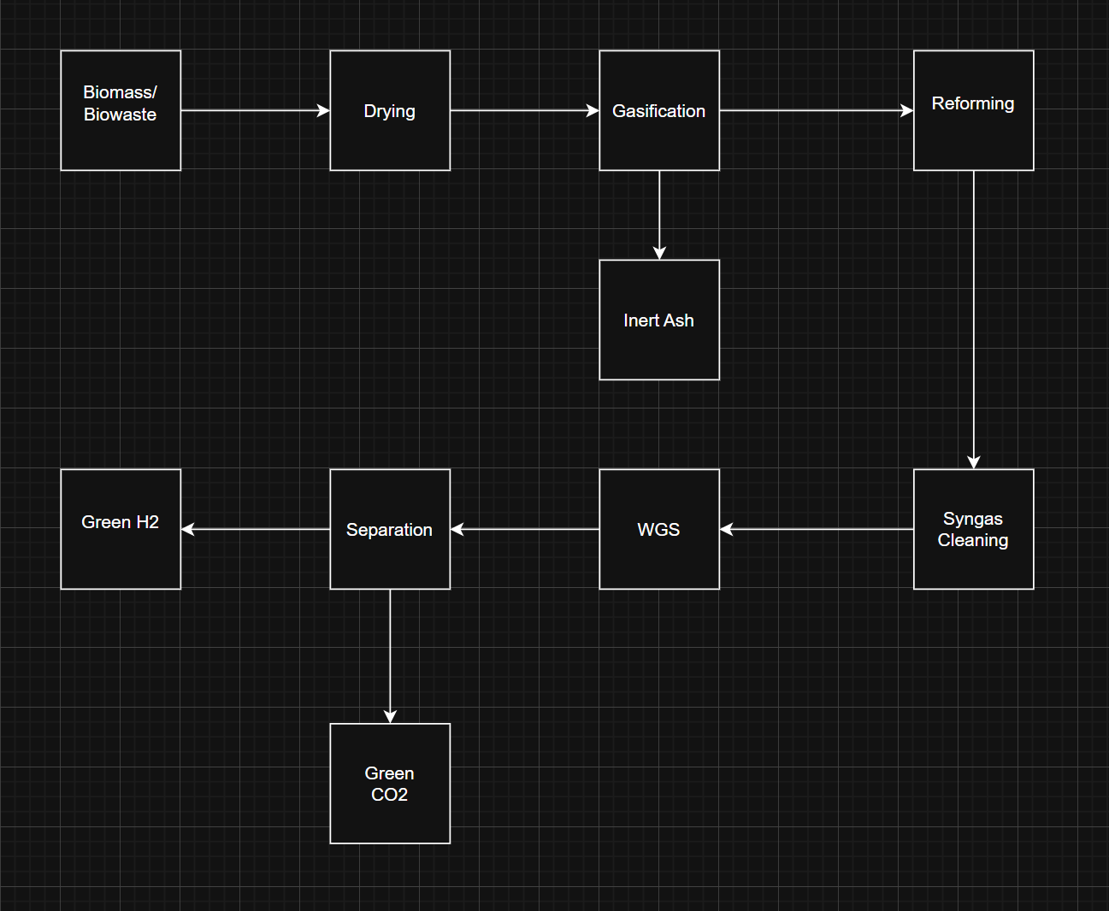
15

Slide 16
Plant Location
16

Slide 17
Plant Location- California
Large Feedstock Availability
17

Slide 18
Plant Location- California
Large Feedstock Availability
Strong Financial Incentives
18

Slide 19

Plant Location- California
Large Feedstock Availability
Strong Financial Incentives
Proximity to Aerospace Industry
Plant size- 300M lbs / Yr
19

Slide 20
Chemistry
20

Slide 21
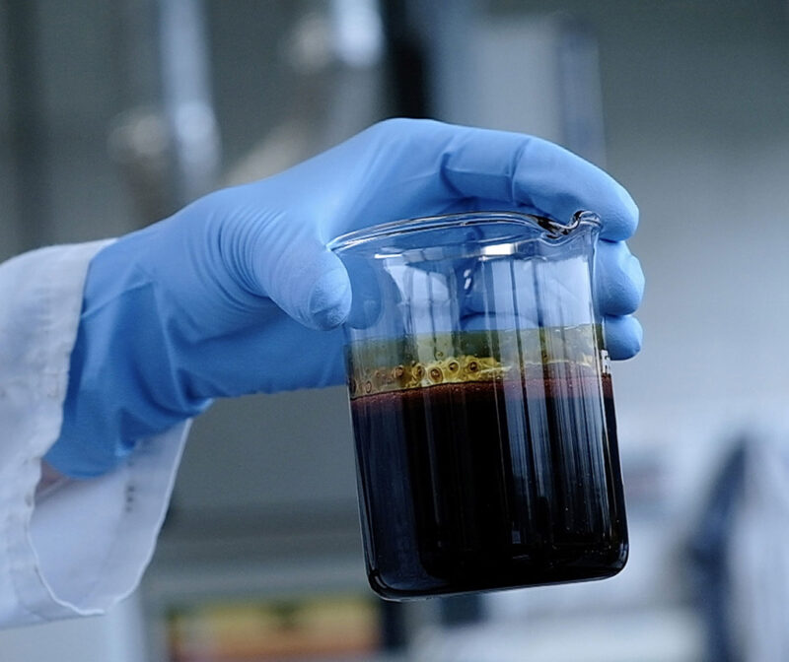
Untreated bio-oil is a dark brown liquid with ~25% water that can’t be easily separated Unstable in long term storage, and not miscible with any conventional hydrocarbon based fuels
Bio-Oil Upgrading
Biobased Chemicals - BTG Bioliquids. BTG Bioliquids. https://www.btg-bioliquids.com/market/biobased-chemicals/ (accessed 2025-12-10).
21

Slide 22

Chemistry of Bio-Oil Upgrading
$C_{n}COOH→C_{n+1}+2H_{2}O [Hydrodeoxygenation]$
$C_{n}COOH→C_{n}+{CO}_{2} [Decarboxylation]$
Dual Stage Hydrotreating: mild to severe hydrotreating to ensure reactivity of bio-oil
Almost completely deoxygenated by combination of hydrodeoxygenation and decarboxylation
Less than 2% oxygen remains in treated stable oil
22

Slide 23
BFD
23

Slide 24




Process Overview
01 Fast Pyrolysis
02 Bio-Oil Stabilization Upgrading
03 Distillation of Stable Oil
Biomass to Bio-Oil
Bio-Oil to Stable Oil
Stable Oil to RP-1
24

Slide 25
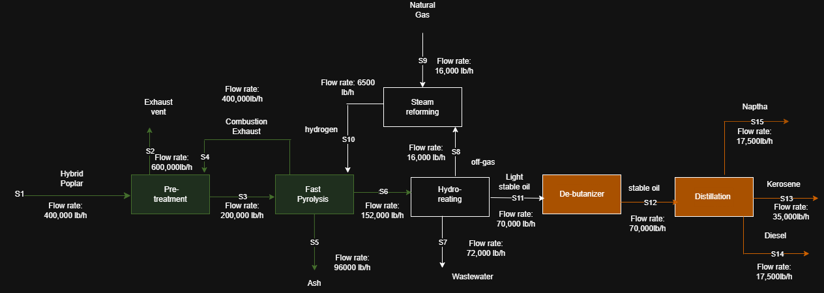
Overall BFD
25

Slide 26
Value Chain
Stage | Value Added | Major Cost | Risk
Pyrolysis | Conversion of biomass into bio-oil | Reactor heat, sand recycle | Tar formation
Hydrotreating | Converts bio-oil to hydrocarbons | H2, catalysts | Catalyst poisoning
Hydrocracking | Produces fuel | H2, pressure, furnaces | Over-cracking, fossil fuel competition
26

Slide 27
PFD
27

Slide 28
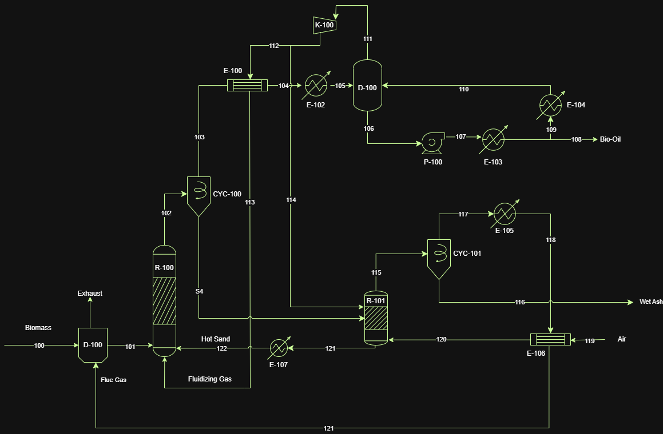
28

Slide 29
29

Slide 30
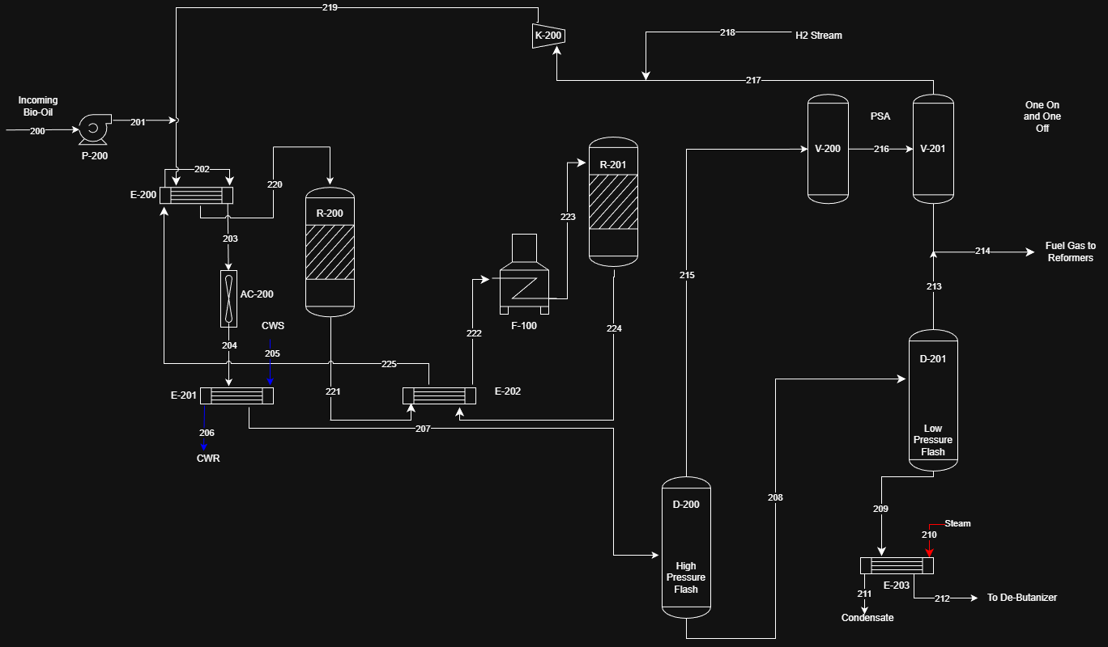
30

Slide 31
31

Slide 32
32

Slide 33
33

Slide 34
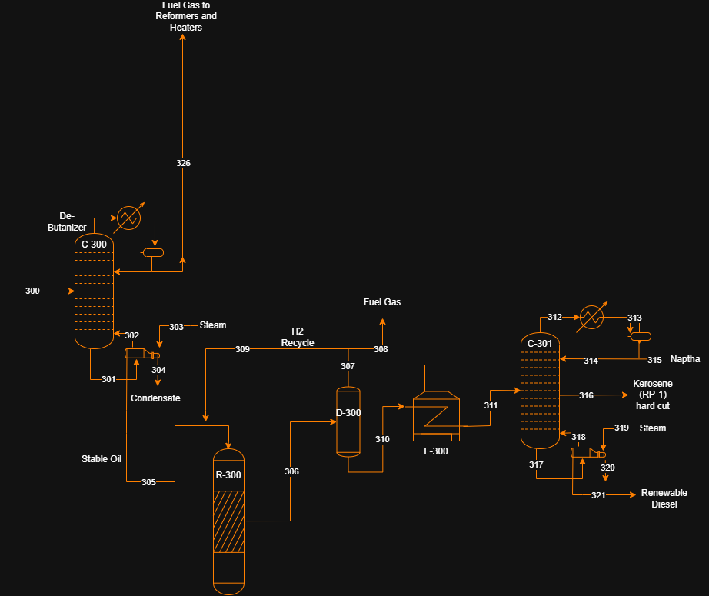
34

Slide 35
Thank You
Questions?
35

Slide 36
Back up slides

Slide 37
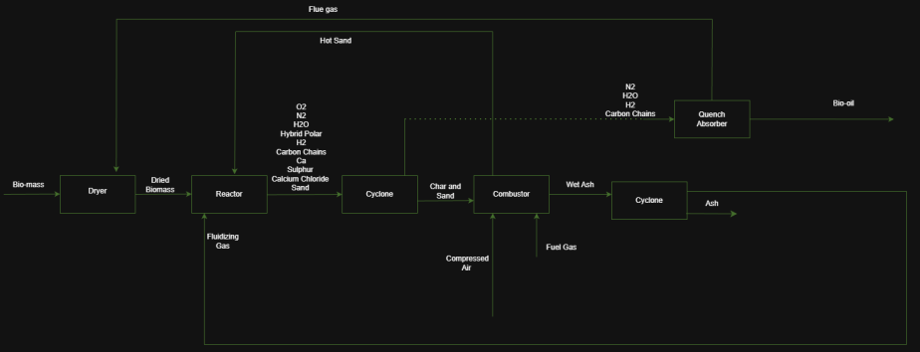
Fast Pyrolysis

Slide 38
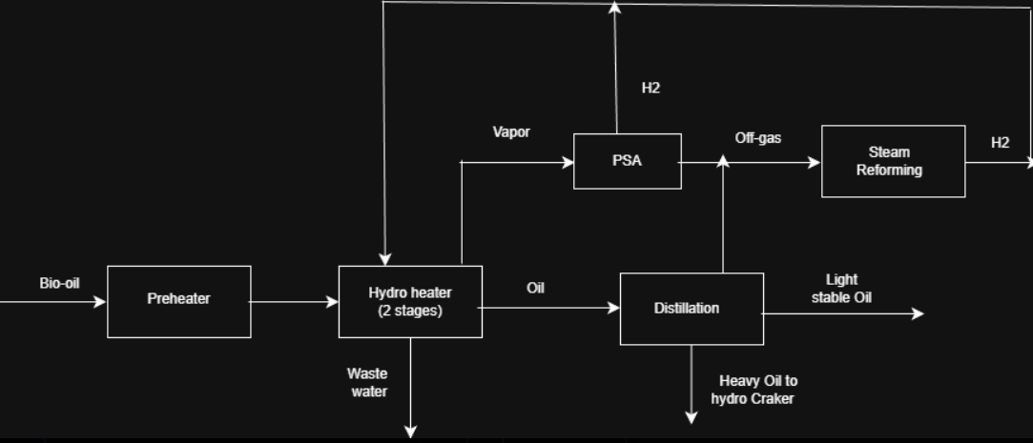
Bio-Oil Stabilization Upgrade

Slide 39
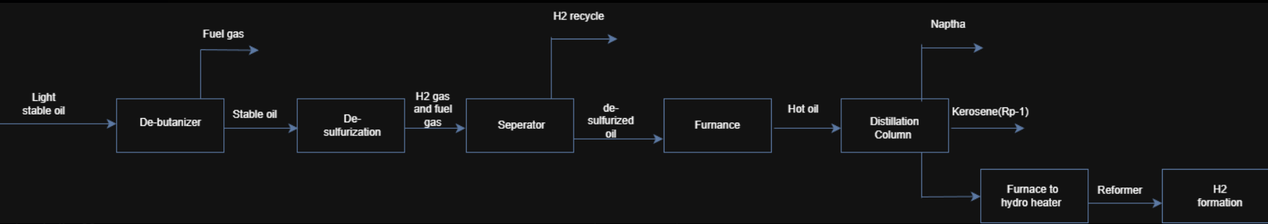
RP-1 Production

Slide 40
References
(1) Diebold, J. P.; Bridgwater, A. V. Overview of Fast Pyrolysis of Biomass for the Production of Liquid Fuels. 1997, 5–23. https://doi.org/10.1007/978-94-009-1559-6_1.
(2) Jones, S.; Holladay, J.; Valkenburg, C.; Stevens, D.; Walton, C.; Kinchin, C. PNNL-18284 Production of Gasoline and Diesel from Biomass via Fast Pyrolysis, Hydrotreating and Hydrocracking: A Design Case; 2009. https://www.pnnl.gov/main/publications/external/technical_reports/PNNL-18284.pdf.
(3) Khlystov, N.; Markovitz, G. Space is booming. Here’s how to embrace the $1.8 trillion opportunity. World Economic Forum. https://www.weforum.org/stories/2024/04/space-economy-technology-invest-rocket-opportunity/.
‌(4) Parvari, E.; Mahajan, D.; Hewitt, E. L. A Review of Biomass Pyrolysis for Production of Fuels: Chemistry, Processing, and Techno-Economic Analysis. Biomass 2025, 5 (3), 54. https://doi.org/10.3390/biomass5030054.
(5) Rocha de Castro, D. A.; da Silva Ribeiro, H. J.; Hamoy Guerreiro, L. H.; Pinto Bernar, L.; Jonatan Bremer, S.; Costa Santo, M.; da Silva Almeida, H.; Duvoisin, S.; Pizarro Borges, L. E.; Teixeira Machado, N. Production of Fuel-like Fractions by Fractional Distillation of Bio-Oil from Açaí (Euterpe Oleracea Mart.) Seeds Pyrolysis. Energies 2021, 14 (13), 3713. https://doi.org/10.3390/en14133713.
‌

